Slide 1

Department of Information Technology
BVRIT Hyderabad College of Engineering For Women
Presentation
on
CUSTOMER SEGMENTATION USING MACHINE LEARNING
Mini Project Review- II
Dated: 16 July 2021
Guide:- Dr. Aruna Rao S.L
Professor & Head Department of IT
Presented by
D. Sai Meghana Reddy(20WH1DB002)

Slide 2
Agenda
Introduction
Literature Survey
Technologies
Problem Statement
Proposed Method
System Architecture
Societal Impact
Project Modules
Results
Conclusion
Reference

Slide 3
Introduction
The emergence of many competitors and entrepreneurs has caused a lot of tension among competing businesses to find new buyers and keep the old ones. As a result of the predecessor, the need for exceptional customer service becomes appropriate regardless of the size of the business.
The identification of customers and satisfying the demands of each customer is a very complex and tedious task.
Big data ideas and machine learning have promoted greater acceptance of automated customer segmentation approaches in favor of traditional market analytics that often do not work when the customer base is very large.

Slide 4
Introduction
Companies that deploy customer segmentation are under the notion that every customer has different requirements. Companies aim to gain a deeper approach of the customer they are targeting. This way, they can strategize their marketing techniques more efficiently and minimize risk to their investment.
The customer segmentation technique allows business to gain a competitive edge over rival companies and increase their marketing efficiency, making better profits and attracting new customers. It also helps an organization to determine new market opportunities, identifying customers retention.

Slide 5
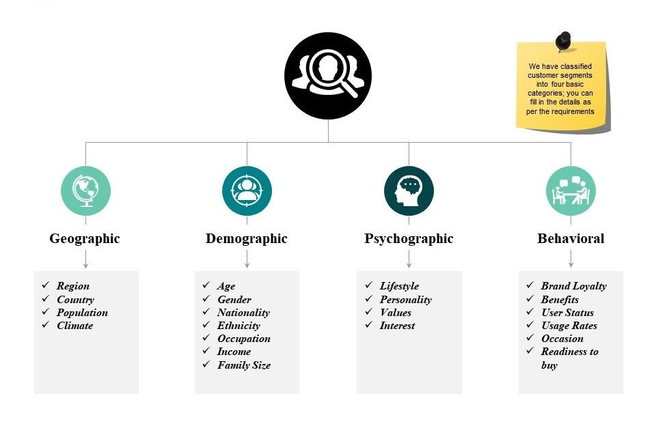
Types of Segmentation Factors

Slide 6
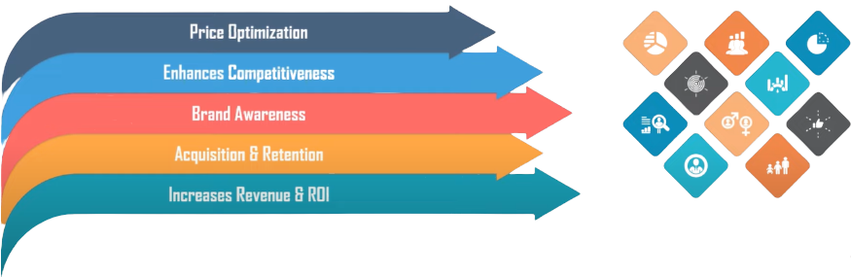
Advantages of Customer Segmentation

Slide 7
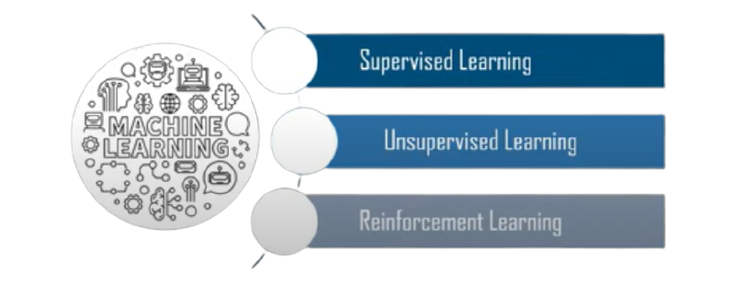
Why Machine Learning?
Machine learning models can process customer data and discover patterns difficult to spot through intuition and manual examination of data

Slide 8
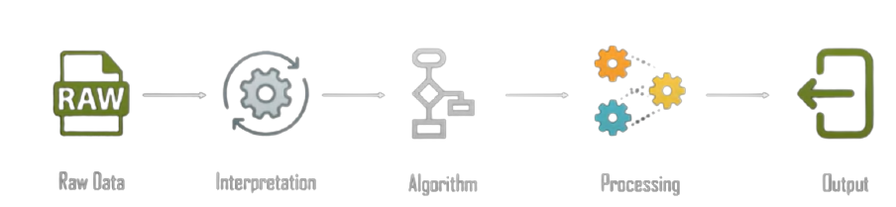
Introduction to Unsupervised Learning
It involves training of machine using information that is neither classified nor labelled and allowing the algorithm to act on that information without guidance.
Types: Association, Clustering

Slide 9
Literature Survey
AUTHOR | TITLE | DESCRIPTION
1. Yash Kushwaha and Deepak Prajapati | Customer Segmentation using K-Means Algorithm | In this paper, the clustering algorithm used is K-means algorithm which is the partitioning algorithm, to segment the customers according to the similar characteristics. To determine the optimal clusters, elbow method is used.
2. Sruthi Janardhanan and Raja Muthalagu | Market segmentation for profit maximization using machine learning algorithms | In this research paper we discover the valuable information that is weekly sales and develop an efficient business strategy model to increase the profitability of the market through supply as well meet the demands of the customers.

Slide 10
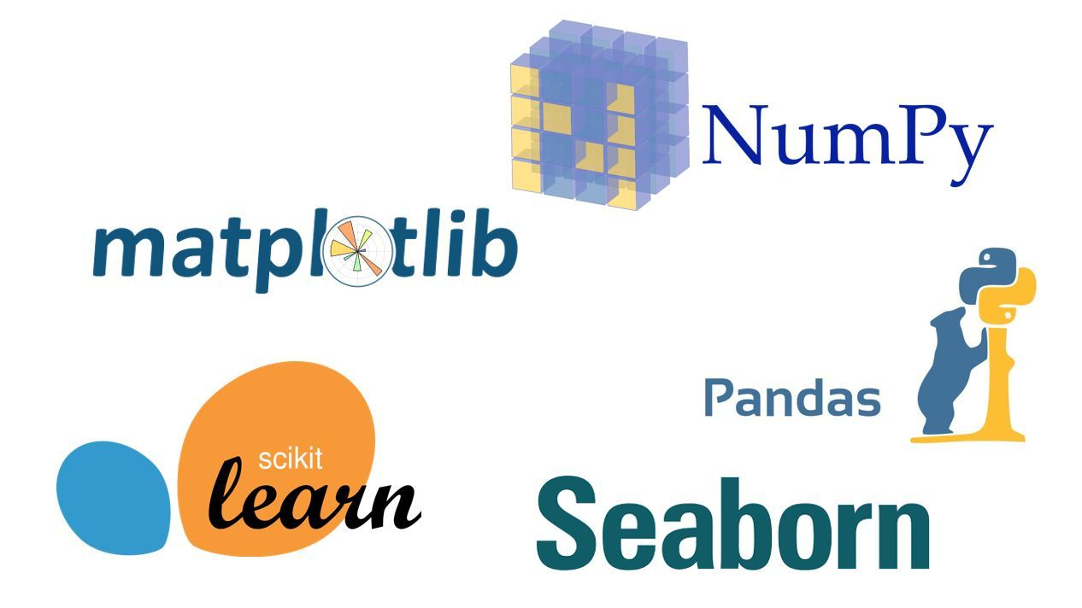
TECHNOLOGY
Domain :
Machine learning
programming language:
Python
Libraries:
Numpy
Pandas
scikitlearn
Matplotlib
Seaborn

Slide 11
Problem Statement
The thrust of this project is to identify customer segments using the data mining approach, using the partitioning algorithm called as K-means clustering algorithm. The elbow method determines the optimal clusters.
Use K-means clustering and also visualize the gender and age distributions. Then analyze their annual incomes and spending scores.
The data set used to implement clustering and K means algorithm is collected from a store of shopping mall.

Slide 12
Proposed Method & Architecture

Slide 13
Proposed Method
To implement a Customer Segmentation application. Clustering is being used to identify segments of customers to target the potential user base. They divide customers into groups according to common characteristics like gender, age, interests, and spending habits so they can market to each group effectively.

Slide 14
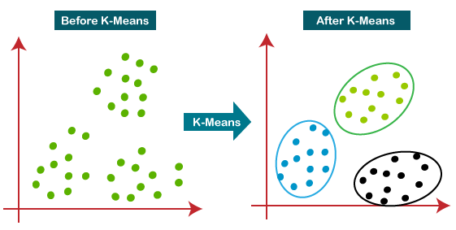
K-means Algorithm
It is an iterative algorithm that divides the unlabelled dataset into k different clusters in
Such a way that each dataset belongs only one group that has similar properties.

Slide 15
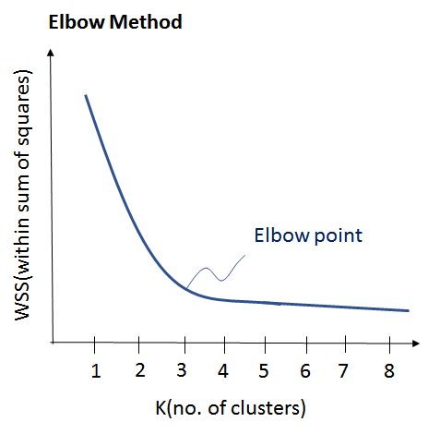
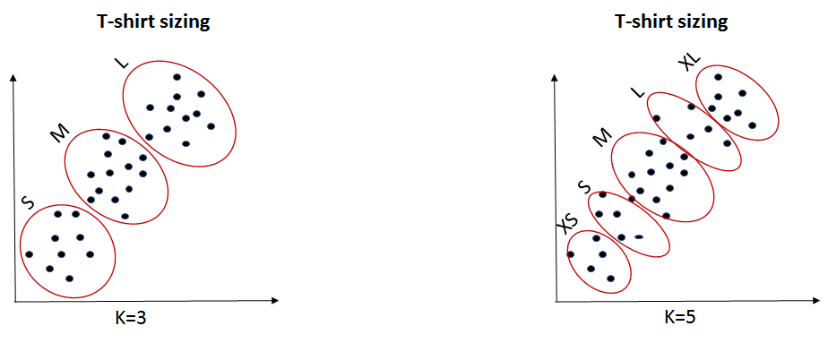
K-means Algorithm
Ways to chose optimum K value
Elbow Method
Purpose Based

Slide 16
System architecture
ENVIRONMENT | SPECIFICATIONS
HARDWARE | OS - Windows 10
 | Processor - Intel Core i5
 | GPU
 | Memory(RAM) - 8 GB
SOFTWARE | Chosen IDE : Jupyter notebook Domain : Machine learning Programming language: Python

Slide 17
social impact
Market segmentation allows service providers, implementers, policymakers, and government officials to target initiatives and lead to a greater likelihood of lasting behavioural change.

Slide 18
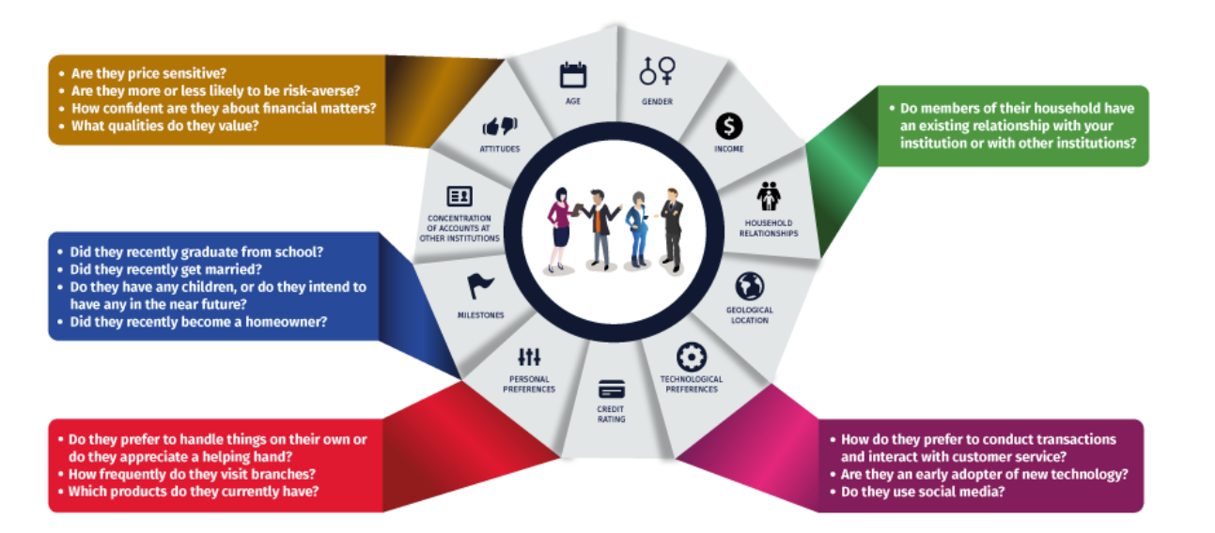
CUSTOMER Segmentation in SBI life Insurance
This case requires to develop a customer segmentation to give recommendations like saving plans, loans, wealth management, etc. on target customer groups.

Slide 19
Customer Segmentation in the Beauty Industry
To be efficient with your time, money, and resources, segmentation will assist you as a marketer. It allows companies to learn about their customers and gain a clear understanding of their needs and wants. With this information, you can use it to tailor campaigns to customer segments who are more likely to purchase your products.
Traditional Consumer
The traditional Consumer who is typically influenced by social media when making their purchases. They are always in pursuit of the latest trends and don’t necessarily know what they are doing when it comes to makeup expertise. These same customers may more than likely stick to re-purchasing items they have already used or purchase “word of mouth” recommendations.

Slide 20
Customer Segmentation in the Beauty Industry
New Consumer
This is someone who is starting their makeup and skincare journey! Whether they are first-time beauty using adults or middle school girls experimenting with eyeliner. It is their first time experimenting with beauty products. They have a curiosity towards trying new products but will trust the recommendations of people like Beauty Guru YouTubers.
Beauty Lover
This is the audience that can be considered lead customers. They understand your use, positioning, and appeal when it comes to new products as they are frequent viewers of the YouTubes beauty community and scavenge the internet for all the latest beauty news so that they can be the first to buy the newest beauty products. They want to be ahead of the trends and typically are makeup collectors.
Beauty Expert
A professional makeup artist is more likely to be loyal to particular brands. When they know a product works universally, it will ensure that they have that reliability and consistency in their work and for their clients. The beauty industry is bigger than ever, and with such massive growth up and coming, beauty brands have the chance to amplify their range of customers.

Slide 21
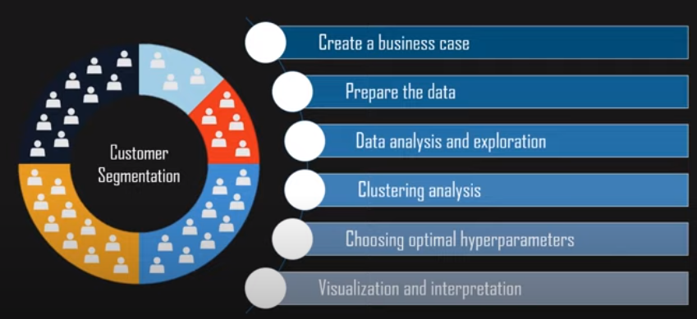
Project Modules

Slide 22
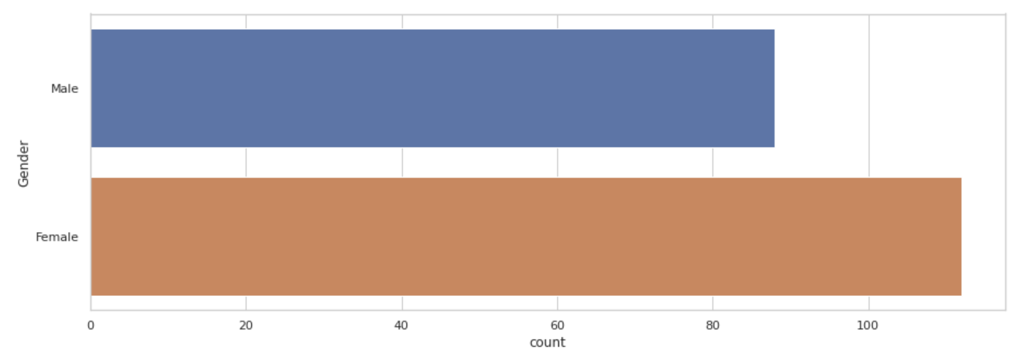
Expected Results
Implementation and Analysis
On performing data visualization on the dataset, a lot of insights were obtained such as:
Gender Plot Analysis
From the Count plot, it is observed that the number of Female customers is more than the total number of Male customers.

Slide 23
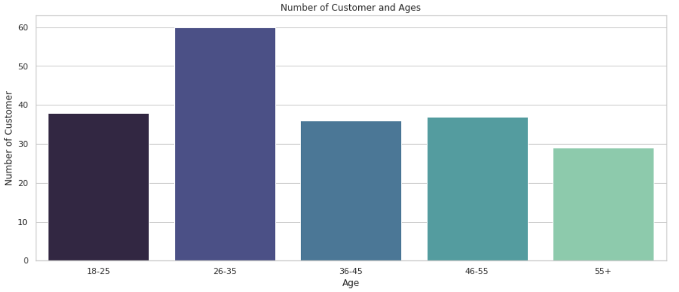
Age Plot
Age Plot Analysis:
From the bar plot it is evident that 26–35 age group outweighs every other age group.

Slide 24
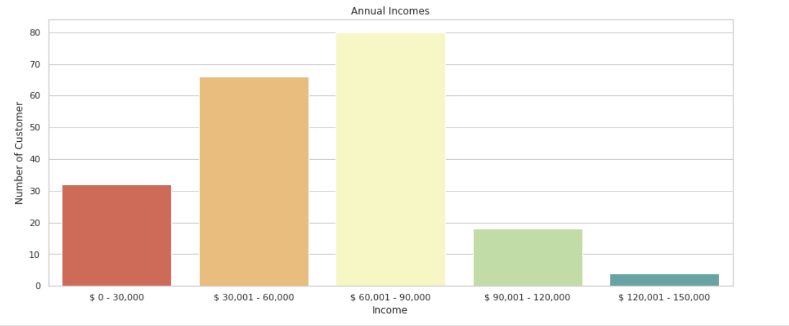
Income Plot
Income Plot Analysis:
From the bar plot it is evident that $ 60,001-90,000 Income group outweighs every other Income group.

Slide 25
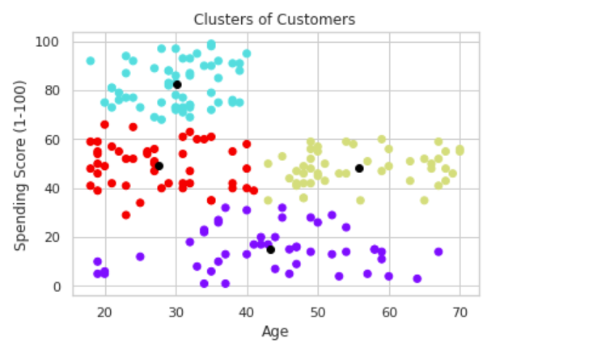
Scatter plot based on Age and spending score
Age Vs Spending Score Analysis
From the Age Vs Spending Score plot we observe that customers whose spending score is more than 65 have their Age in the range of 15-42 years.
The customers having average spending score ie: in the range of 40-60 consists of the age group of the range 15-75 years

Slide 26
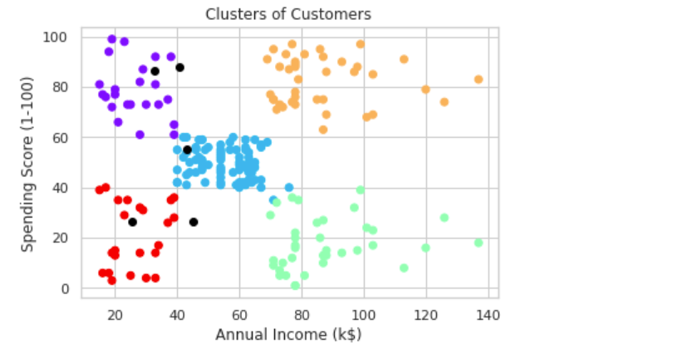
Annual Income Vs Spending Score Analysis
We observe that there are 5 clusters and can be categorized as:
High Income, High Spending Score (Top Right Cluster)
High Income, Low Spending Score (Bottom Right Cluster)
Average Income, Average Spending Score (Center Cluster)
Low Income, High Spending Score (Top Left Cluster)
Low Income, Low Spending Score (Bottom Left Cluster)

Slide 27
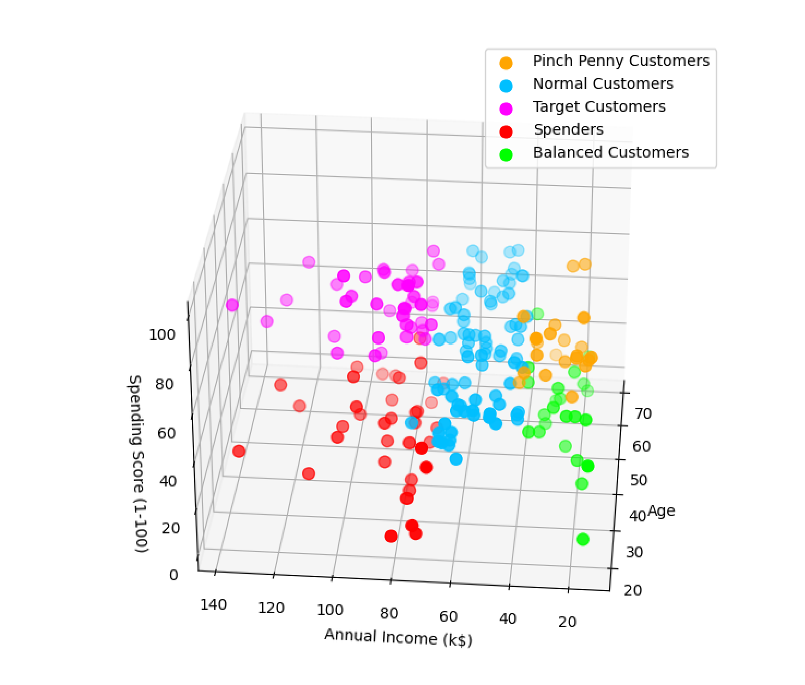
3D VISUALIZATION

Slide 28
Conclusion
We approached customer segmentation problem from a behavioural aspect with the number of products ordered, average return rate and total spending for each customer. Use of 3 features helped us with the understandability and visualization of the model.
One of the major application of K means clustering is segmentation of customers to get a better understanding of them which in turn could be used to increase the revenue of the company.
Customer segmentation can have a positive impact on business if done properly.

Slide 29
Reference
[1] I. S. Dhillon and D. M. Modha, “Concept decompositions for large sparse text data using clustering,” Machine Learning, vol. 42, issue 1, pp. 143-175, 2001.
[2] T. Kanungo, D. M. Mount, N. S. Netanyahu, C. D. Piatko, R. Silverman, and A. Y. Wu, “An efficient K-means clustering algorithm,” IEEE Trans. Pattern Analysis and Machine Intelligence, vol. 24, pp. 881-892, 2002.
[3] MacKay and David, “An Example Inference Task: Clustering,” Information Theory, Inference and Learning Algorithms, Cambridge University Press, pp. 284-292, 2003.
[4] Jiawei Han, Micheline Kamber, Jian Pei “Data Mining Concepts and Techniques”, Third Edition.
[5] D. Aloise, A. Deshpande, P. Hansen, and P. Popat, “The Basis Of Market Segmentation” Euclidean sum-of-squares clustering,” Machine Learning, vol. 75, pp. 245-249, 2009.
[6] S. Dasgupta and Y. Freund, “Random Trees for Vector Quantization,” IEEE Trans. on Information Theory, vol. 55, pp. 3229-3242, 2009.
[7]Puwanenthiren Premkanth, ―Market Segmentation and Its Impact on Customer Satisfaction with Especial Reference to Commercial Bank of Ceylon PLC.‖ Global Journal of Management and Business Research Publisher: Global Journals Inc. (USA). 2012. Print ISSN: 0975-5853. Volume 12 Issue 1

Slide 30


